Slide 1
MyFunctionalSystem
Dylan Ingrey, David James, Cody Moorhouse, John Mulvany-Robbins

Slide 2
Problems with the current system
works crappy on mobile platoform
painfully slow to load
poor user interface – no way of going back
interface isnt very modern and looks ugly
current back end has severe downtime on sundays from 7pm-9pm, and on every second sunday there are outages from 6am-noon. ideally much of the cause of these outages could be automated and prevented.
Scalability – make the system more responsive on major deadlines

Slide 3
Proposed Solution – Android Platform
Better interface (definitely the ability to go back)
Hallway testing the interface with other faculties that dont have a major focus on computers (chemistry, psychology)
Easily testable in android studio
Automated back end for database management to try to help reduce and prevent downtime
web framework to communicate (REST)

Slide 4
Initial Requirements Analysis
Webserver framework
  Infrastructure (hosted for testing)
  Database
    Courses
    Rooms
    People
  App (connects to the server)
Android Studio

Slide 5
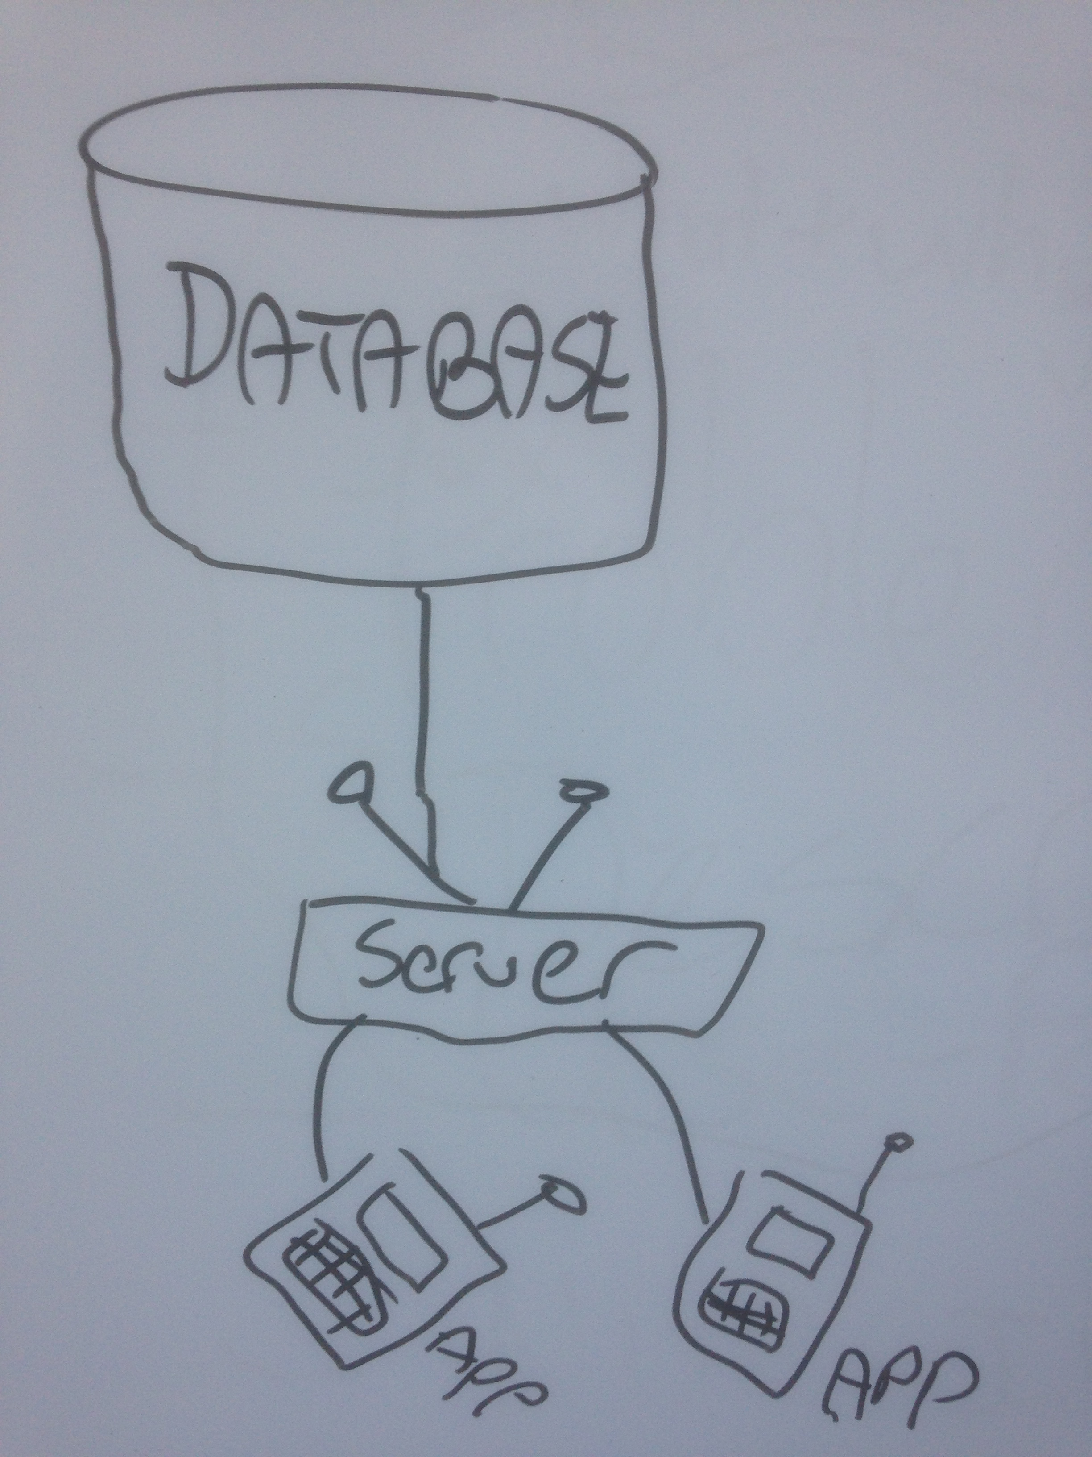
Design
Database → Server → Multiple App Instances

Slide 6
Data Sets - Classes
Person
  Student
  Employee
    Prof
    Admin
Course
  Section (collection)
    Class time (collection)
  Permission/Pre-reqs
(enrollment) Person + Classes
Department
  List of Courses (collection)
  Dept Code (CMPT)
  Room Number
  List of Employees (collection)

Slide 7
Data Sets – Person Attributes
ID
first name/preferred name
middle name
last name
email
netID
gender
birthday
phone number
address (broken up into further details)
passwords (hashed + salt)
creation date
last modification date

Slide 8
Data Sets – Course Attributes
ID
Title (CMPT305)
Description
Career (what academic level? certificate, diploma, ugrad, grad, phd)
Sections (collection)
Term

Slide 9
Data Sets – Section Attributes
ID
Type (LAB, SEM, LEC)
Permissions – prereqs, overrides
Time (start, end, days)

Slide 10
Data Sets – Employee Attributes
ID
SIN
Salary
Dept Code
Role
Sections(collection)

Slide 11
Data Sets – Department
List of Courses (collection)
Dept Code (ie. CMPT)
Room Number
List of Employees (collection)

Slide 12
Libraries
Database Connector
REST framework
Android GUI (graphics)

Slide 13
Timetable - Tasks
Web Server
  David
    communicate with database (CRUD app)
Database
  John/David
    tabes
    queries
      adding/removing entries
App
  Dylan
  Cody
    super classes
    very basic interface
    local database copy
    methods
    parsing json

Slide 14
Timetable – Schedule
October 20th
  ^{database schema done}
  ^{ER Diagram}
  ^{Superclasses}
October 27th
  ^{Basic GUI}
  ^{Web Server Running}
November 3rd
  ^{Course Searching}
November 10th
  ^{functionality (elements, etc)}
November 17th
  ^{functionality (elements, etc)}
November 24th
  Completely Done (tweaking stages)
December 1st
  Due Date (6 weeks total work time)

